Slide 1

Hyfforddiant Mandadau
2017/2018
Mandate Training 2017/2018

Slide 2
Finance Office
The Finance office is located at the SU Welcome Desk.
Opening Times
10:00-16:00 Monday to Thursday
10:00-15:00 Friday
Function
The finance office will provide you with information about your club/society accounts. All financial transactions will be conducted at the finance office.
Useful Contacts
The finance office is contactable via email at sufstaff@aber.ac.uk and telephone on 01970 621727. We will endeavour to respond to your enquiries within three working days.

Slide 3
Setting up an account
Complete a mandate from (available from the SU Welcome Desk).
- A photograph and the signature of both mandated persons must be included on the form.
- There must only be two people on the mandate form, normally the president and treasurer.
- Only the people on the mandate form can authorise expenditure from the account.
2. Set up an aber.ac.uk email for your club/society
- The link to set up an email account can be found in your mandate training booklets.
- Requests for an email account will only be authorised once the finance office is in receipt of your completed mandate form.

Slide 4
Responsibilities of the Mandates
The mandated persons are responsible for the club/society accounts. Mandated persons must be current students.
Reconciling accounts
The finance office may make random checks on club/society accounts to make sure that they are being managed correctly. We will ask to see your accounting records and will reconcile them against the ones we keep.
Reporting club/society finances
The mandated persons have a responsibility to periodically report their finances to their comittee
Overdrawn accounts
Sometimes accounts become overdrawn. If this happens your account will be frozen until monies are paid in to bring your account back into credit. The responsibility for this and for payments of any bills, or part of bills, incurred after the account became overdrawn rests with the mandated signatories.

Slide 5
Bookkeeping Example
Date | Details | Expenditure | Income | Balance
01/09/2017 | Bal b/f |  |  | £ 100.00
10/09/2017 | Membership |  | £ 50.00 | £ 150.00
20/09/2017 | Merchandise |  | £ 200.00 | £ 350.00
25/09/2017 | Payment for merchandise | £ 200.00 |  | £ 150.00
30/09/2017 | Sponsorship |  | £ 25.00 | £ 175.00

Slide 6
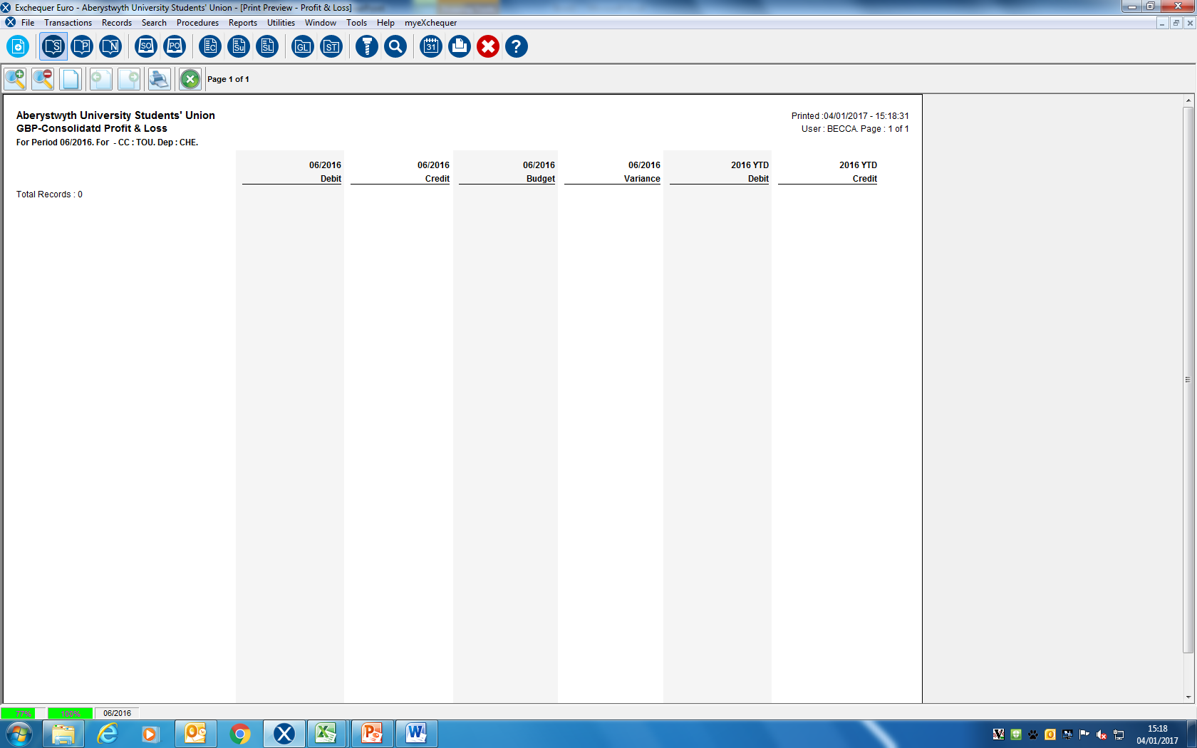
Your accounts
Expenditure for the current month
Income for the current month
Ignore these columns
Expenditure totals for the year
Income totals for the year
Month | Finance Date
July | 01/2017
August | 02/2017
September | 03/2017
October | 04/2017
November | 05/2017
December | 06/2017
January | 07/2017
February | 08/2017
March | 09/2017
April | 10/2017
May | 11/2017
June | 12/2017
Details of expenditure/income
XXXXX
Funds available

Slide 7
Your accounts
Each club/society has one main account and 3 sub-accounts.
General Account
The general account is used for paying membership, sponsorship, merchandise and also for any general expenditure.
Expenditure from the general account must be for items that benefit the whole club/society.
Dinner
The dinner account is used for Christmas and end of year meals. All money for dinners must be paid into the finance office. The restaurant should issue you with an invoice which can be paid using the dinner account funds.
Tour
The tour account is used for tours or larger trips away. All money for tours must be paid into the finance office. Any expenditure associated with the tour will be paid out of the tour account.
Dinner and tour money is kept separate from the general account as it is accepted that not every member of your club/society will attend these events.
Grant
Each year you have an opportunity to apply for a grant for your club or society. This money comes directly from the SU and is kept in a separate account for you. You can only spend this money on things that you specified in your grant application.

Slide 8
Paying Money In
Anyone can pay money into your accounts; it doesn’t have to be one of the mandated persons. All club/society money should be paid into the finance office as soon as possible. Do not collect and hold large amounts of cash yourself. You must not use personal bank accounts to collect club/society money.
Paying in cash
If you wish to pay cash in to your account you can do so at the finance office. You must fill in an ‘Income Receipt Form’ detailing what it is that you are paying in. Please give an accurate description e.g. hoodie money, match fees, etc. not just ‘money in’. Please also write on the form the account that you would like the money to go into.
Paying in cheques
You can pay in cheques at the finance office. You must fill in an ‘Income Receipt Form’. Please ensure that cheques are made payable to Aberystwyth University Students’ Union and not your individual club/society. Cheques made payable to individual clubs/societies will not be accepted by the bank.

Slide 9
Paying Money In
Paying in online
Income can be also be paid in via the SU website. You will need to fill in the online payment request form in order to set up an online payment. You will find the link to this form in the Mandate Training booklet.
The online payment request forms can take up to two weeks to process, so please plan ahead to ensure we can meet your requirements.
It is essential that the full amount payable for all orders is paid into the finance office before any orders are placed.

Slide 10
Requesting Payments
Requests for payments from your account are made at the finance office. The ‘Payment Request Form’
is used to request a payment from your account.
Only a mandated person can authorise payments from the account however they cannot authorise a payment to themselves. The second signature box on the form will be signed by the activities officer once they agree that club/society funds can be used for the purchase. Please note that the activities officer will refuse payments if they do not deem them acceptable e.g. payments for alcohol.
Payment request forms will only be accepted if a receipt for the purchase or proof of purchase is attached
If a payment due to the club/society member is £40 or under, they will be able to come to the finance office to collect the payment in cash
If a payment due to the club/society member is over £40 it will be paid via direct bank transfer. You need to fill in their name, account number and sort code on the form
You must include the payee’s email address on the payment request form

Slide 11
Paying invoices
Invoices are paid via the finance office
If you receive an invoice for your club/society you must bring it to the finance office as soon as possible.
One mandated person will need to authorise the invoice by signing a slip obtained at the finance office.
Invoices can be paid via cheque or by direct bank transfer.
Cheque runs are done approximately once every two weeks, so please bear this in mind if your supplier need payment by cheque.
BACS runs are done once a week on a Friday. Funds take 3 working days to clear into a supplier’s account so will be with them the following Wednesday. Please note that invoices and payment request forms must be handed in to the finance office by 12pm on a Wednesday to ensure payment by the following Wednesday. Payment request forms and invoices handed in later than this will not be paid until the following week.

Slide 12
Purchase Order Procedure
A purchase order is a document that is given to your supplier to assure them that you have the money to pay them.
Prior to any order being raised, money covering the full cost of the purchase must be paid into the club/society account. Purchase orders are processed in the finance office.
Collect a purchase order form from the finance office.
Pay the money for the purchase into the correct account e.g. general, dinner, tour.
Return completed purchase order form to the finance office.
Place the order with your supplier.
Finance will process your purchase order.
Once you receive your order
6. Check the goods that have been delivered. If you have any queries with your order you must contact your supplier. The finance office and the activities officer can help you with this if needed.
7. Promptly bring the invoice to the finance office so that it can be paid in accordance with the suppliers’ payment terms.

Slide 13
Sponsorship
Sponsorship forms are available from the finance office. Sponsorship forms are not a legally binding document but allow you to keep a record of what has been agreed with your sponsor.
Hand in all completed sponsorship forms to the finance office.
If the ‘invoice’ box has been ticked a sales invoice will be drawn up and sent to the sponsor at the times indicated on the form. Payment is requested within one month of an invoice being issued.
If the ‘cash’ box has been ticked you are responsible for collecting the cash from the sponsor.
Responsibility to chase overdue or outstanding payments lies with the club/society. Remember the sponsor is under no legal obligation to pay.
All sponsorship agreements must adhere to Union policy.
All agreements must be authorised by the activities officer prior to commitment with the sponsor.

Slide 14
Floats
The finance office is able to offer floats of up to £30 for any event that your club/society runs. This will be provided to you in the denominations that you specify.
Requests for float should be sent to sufstaff@aber.ac.uk at least a week before the float is required. You can also request a float at the finance office.
Only a mandated person can request a float and this will be authorised by a member of the finance office.
The float must be returned to the finance office within a week of it being taken. Ensure that the float is paid into the office separately to other income e.g. the income generated from an event.
If the float is not returned within two weeks it will be automatically taken from your account.

Slide 15
Minibus Hire and BUCS Travel
The Union has two minibuses that are available for your club/society to hire.
Minibuses are to be booked with Sion the Societies and Volunteering Co-ordinator.
Minibuses cost £75 for a full day hire and £37.50 for a half day hire. Discounted rates are available over the weekend.
Charges for minibuses will be automatically taken from your account approximately 2 weeks after the date of hire.
You must ensure that there is enough money in your account to pay for the hire before you book a minibus with Sion.
The Union pays for travel to and from BUCS competitions.
If you travel to a competition using a Union minibus, BUCS will cover the cost of the hire of the bus and the cost of the fuel.
You need to use a payment request form to claim back BUCS fuel. Please clearly state BUCS on the form.
If you travel to BUCS competitions in your own vehicle you will be paid either the cost of the fuel as detailed on your receipt or 20p per mile – whichever is the lower amount. Please note that you must be reasonable with your requests. If 5 people are traveling, you will not all be reimbursed if you take a car each.
BUCS does not pay for toll road charges or parking charges.

Slide 16
Dinners and Tours
You will find information about how to book and pay for dinners and tours in the mandate training booklet. If you have any questions about this please contact the finance office on sufstaff@aber.ac.uk or call 01970 621727.

Slide 17
Remember…
If a club/society account become overdrawn, all activity will be frozen.
The tour account, dinner account and grant account are all kept separate from the general activities account.
Money may be raised through membership, sponsorship, fundraising etc.
Only mandated signatories can request financial reports and authorise payments. Reports can be requested by emailing sufstaff@aber.ac.uk
The onus is on mandated persons to report finances to their committee.
Cheques must be made payable to Aberystwyth University Students’ Union and not to individual clubs/societies.
Invoices and payment request vouchers are to be submitted to the finance office by Wednesday 12pm prior to the payment run on Friday.
All money needs to be paid into the finance office before orders are placed.
All purchases and bookings need to be made via the ‘purchase order’ system.

Slide 18
Any Questions?

